Slide 1

Knowledge Discovery from Natural Language Text
Day 12: Special Data Tyles – Natural Language Processing and Text Mining
Finding Needles in the Wordstacks
A/Prof. Wei Liu & Tyler Bikaun
Computer Science and Software Engineering
wei.liu@uwa.edu.au
tyler.bikaun@research.uwa.edu.au

Slide 2


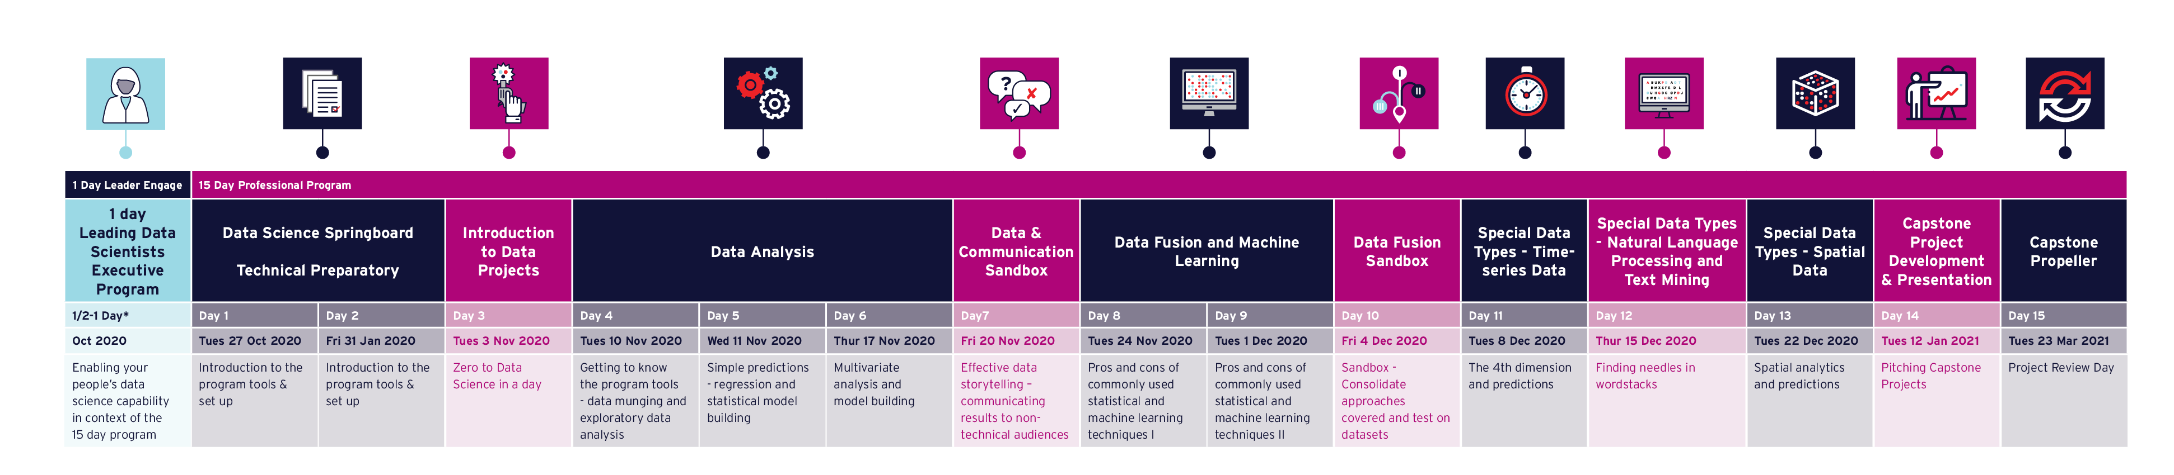

Delivering Data Science to Resources & Energy
Virtual Leader Day and Professional Programs 2020 Perth and Brisbane

Slide 3

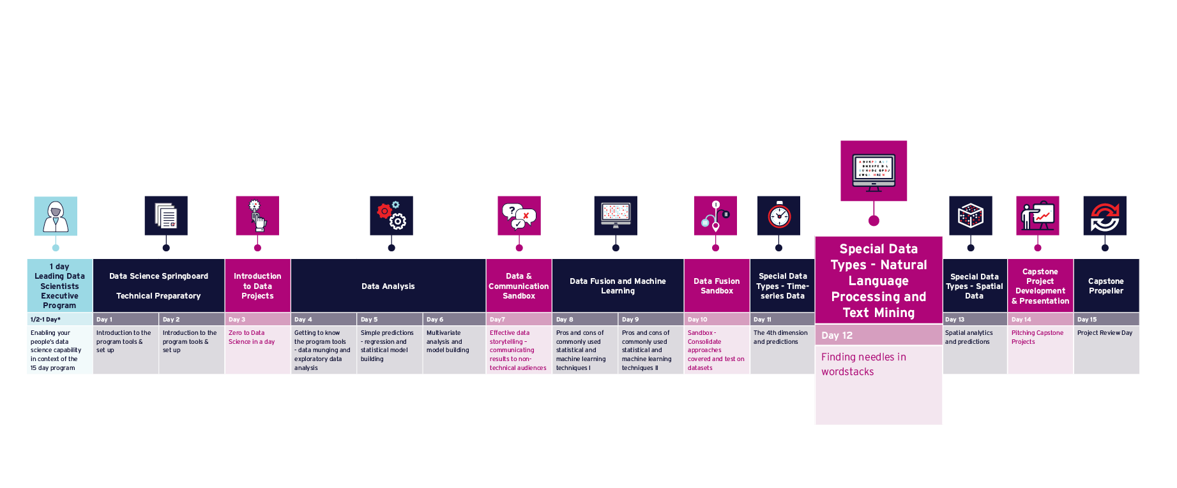
Program Timeline

Slide 4
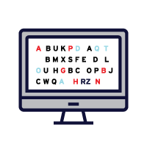
12
Extract text to run ML pipelines over.
Present the practical strategies for using text.
Understand how to handle text.
Understand text pre-processing.
Demonstrate text with supervised and unsupervised learning.

Slide 5
A day on Natural Language Processing and Text Mining
What is today about?
Knowledge Representation
Machine Learning
Computational Linguistic
Natural Language Processing
Word Embeddings
Topic Modelling
Information Extraction
Sentiment Detection
Associate Prof. Wei Liu, UWA

Slide 6
12.0 Overview
What we can get out of Natural Language Texts

Slide 7
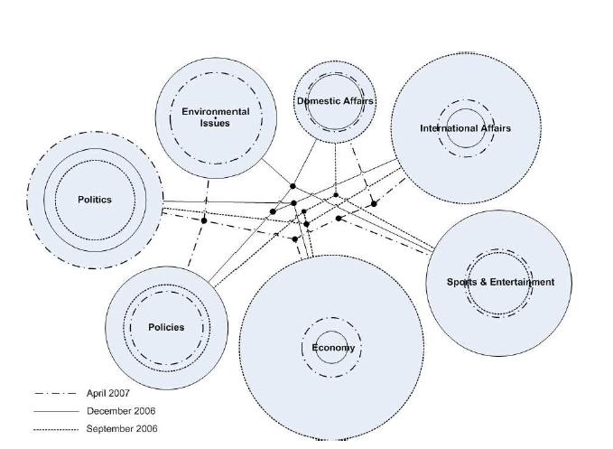
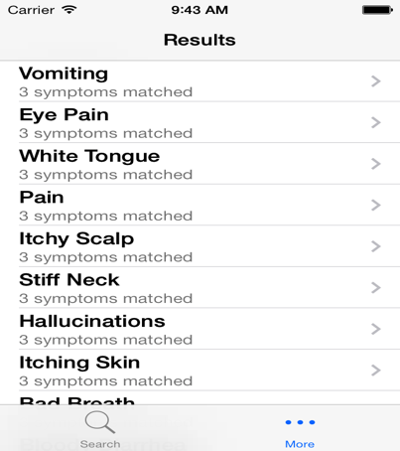
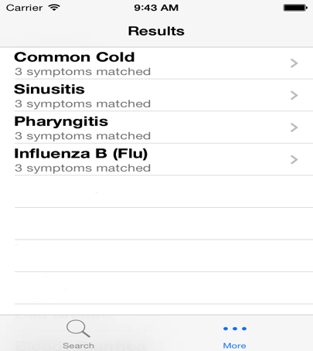
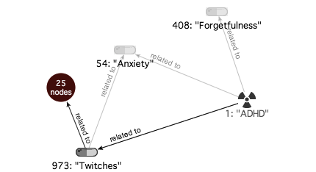
What we can get out of natural language text
Past Projects
Election predication – news article analysis
Medical diagnosis
Pubmed Article Analysis

Slide 8
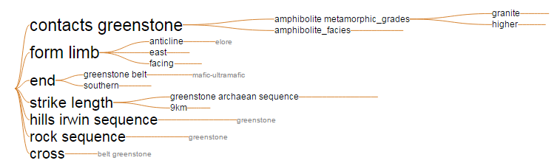
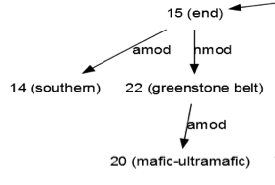
GSWA
Exploration
Report
Part-of-Speech Tagging & Grammar Tree
Stanford Dependency Parser
Grammatically parse sentences in each report
Parts of speech (e.g., nouns, verbs, and adjectives)
Relationships between words (e.g., modifiers, compounds)
Dictionary
Build from a variety of geology related resources
General geology dictionary
Schlumberger oilfields glossary
Other web sources (webpages, databased etc)
Clean extracted terms
Lemmatisation
Noise removal
Noun Phrase Chunker
Summary Graphs & Visualisation
Identify noun phrases
Find complete noun phrases, such as ‘Archean greenstone belt’
Document normalising-splitting sentences-noun phrase identification (using Part-of-Speech pattern)
e.g. <NN.*|JJ>*<NN.*> -- Nouns and Adjectives, terminated with Nouns
Merge grammar tree
Merge compound nouns together, keep modifiers
Provides a visual summary of the report
Page Ranking & Key Noun Phrases
Extract key phrases
Keep phrases if they match our dictionary
Provides key phrase summaries of the report
hole, located, drilling, sequence, work, nickel laterite, mapping, exploration, body, range, bif, potential, period, belt, deposit, terrane, amphibolite, mineralisation, …

Slide 9

Maintenance Work Order Processing
ARC Training Centre for Transforming Maintenance through Data Science
https://www.maintenance.org.au/

Slide 10

Natural and Technical Language Processing
Natural Language Processing
Technical Language Processing
Natural language processing (NLP) is the study of getting computers to understand natural languages.
You probably make use of NLP every day!
Google search
Spellcheckers
Siri
Autocomplete
Technical language processing (TLP) aims to understand technical languages, a subset of natural languages that appears in industry-specific contexts.
Accident reports: | WAlking in car park from office to workshop & roled ankle Injured right wrist lifting wheel barrow off ute
Maintenance work orders: | a/c blowing hot air repace grouser plate to l/h side track
NTLP Research Group at UWA: http://nlp-tlp.org/

Slide 11
Short Text Taxonomy
Short text
Low quality
High quality
Technical language
Domain-specific
Mixed domain
Domain-specific
Mixed domain
Accident reports
Maintenance work orders
Doctor’s notes
Social media posts
Emails
Text messages
Academic documents
Movie reviews
Wiki documents
News reports
Books
Slide courtesy of Dr Michael Stewart’s PhD Thesis

Slide 12
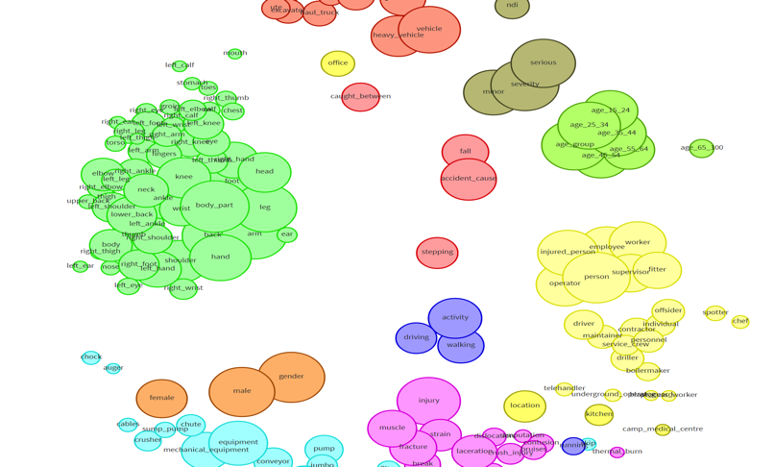
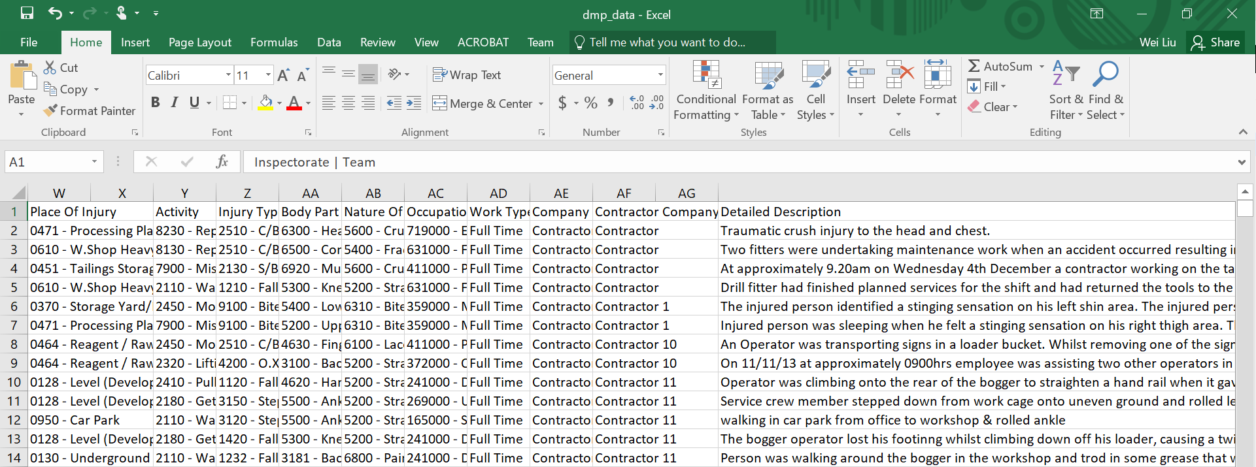
S³ - Semantics
Extracting Semantics – Association Rule Mining
Text Mining - https://nlp-tlp.org/aquila
Associate Prof. Wei Liu, UWA

Slide 13

Aquila – Text Mining Lifecycle
Aquila – Knowledge Discovery from Mining Safety Data
Aquila is a web-based tool for visualising and analysing technical records.
It is designed to be usable by anyone – no programming experience required.
It features a range of unique visualisations that support knowledge discovery.
M Stewart, W Liu, R Cardell-Oliver, M Griffin. An Interactive Web-based Toolset for Knowledge Discovery from Short Text Log Data. 2017 International Conference on Advanced Data Mining and Applications, 853-858.

Slide 14
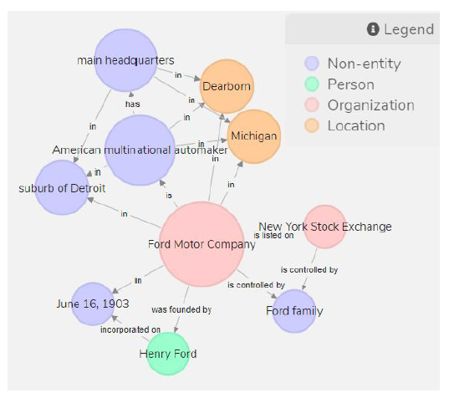
S³ - Semantics
Extracting Semantics – Knowledge Graph Construction from Text
Ford Motor Company is an American multinational automaker that has its main headquarters in Dearborn, Michigan, a suburb of Detroit. The company was founded by Henry Ford and incorporated on June 16, 1903. The company is listed on the New York Stock Exchange and it is controlled by the Ford
family.
Knowledge Graph Construction from Text - https://nlp-tlp.org/text2kg
Associate Prof. Wei Liu, UWA

Slide 15
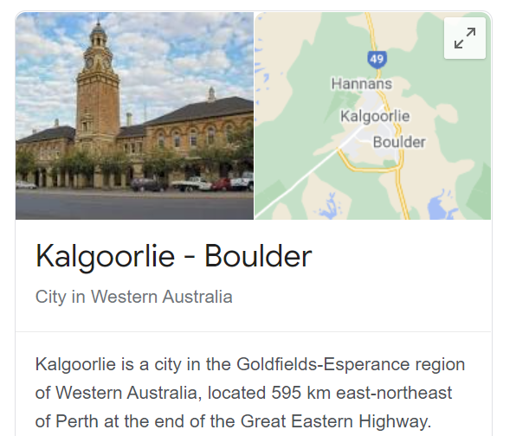
S³ – Social
Extracting “Social” Relations between words
Kalgoorlie + iron-ore –gold = ???
Associate Prof. Wei Liu, UWA

Slide 16
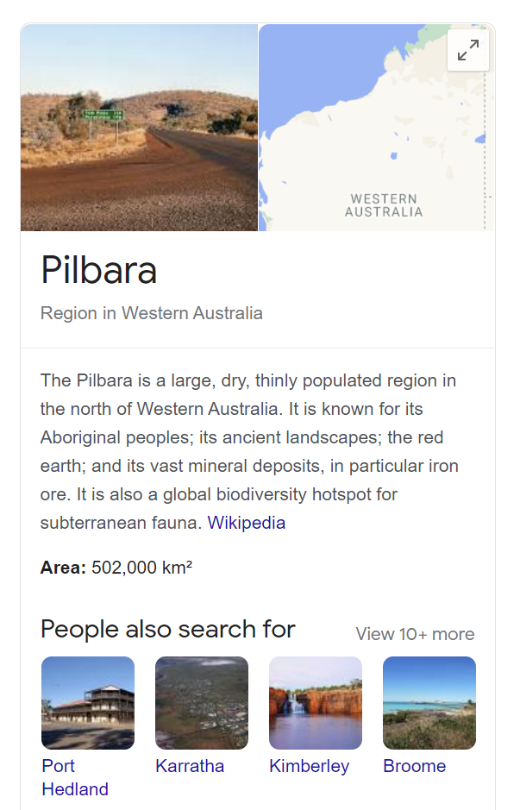
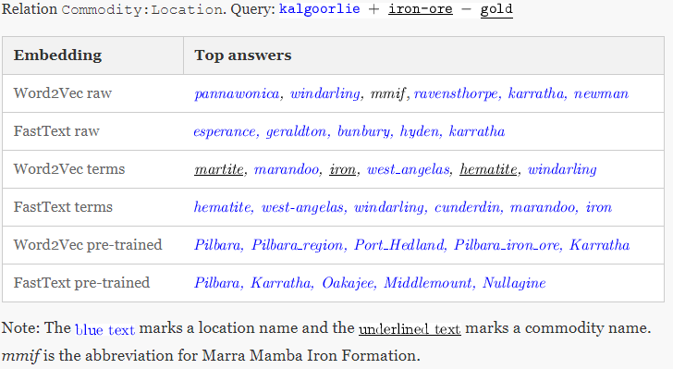
S³ - Social
Extracting “Social” Relations between words
Associate Prof. Wei Liu, UWA

Slide 17
S³ - Sentiment
Extracting Sentiment from Text
Associate Prof. Wei Liu, UWA

Slide 18
S³ - Sentiment
Extracting Sentiment from Text
Dow Jones
CALM
Johan Bollen, Huina Mao, Xiaojun Zeng. 2011. Twitter mood predicts the stock market,
Journal of Computational Science 2:1, 1-8. 10.1016/j.jocs.2010.12.007.
Associate Prof. Wei Liu, UWA

Slide 19
12.1 Traditional NLP Pipelines

Slide 20
12.1 NLP Pipelines – Ontology Learning from Text
Knowledge Representation
Machine Learning
Computational Linguistic
Graphs in knowledge representation
Two different sources
Knowledge experts (logic based)
Knowledge discovery (from natural language texts)
Ontology learning
Entity Extraction
Symbolic
Unsupervised learning
Supervised learning
Subsymbolic
Deep learning
Entity Relation Extraction
Associate Prof. Wei Liu, UWA

Slide 21
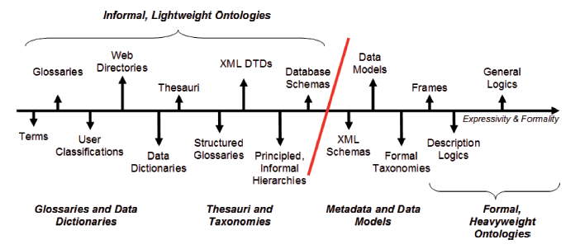

12.1 Lightweight Ontologies
Overview – What’s Light Weight Ontology
Wilson Wong, Wei Liu, and Mohammed Bennamoun. (2012) Ontology Learning from Text: A look back and into the future, ACM COMPUTING SURVEYS, 44, 4, Article 20, pp. 20:1-20:36
Associate Prof. Wei Liu, UWA

Slide 22
text > sets of corpora are prepared for ontology construction. Web Crawling is performed to gather web pages from general sources such as Reuters, Discovery and CNet to create the Contrastive Corpus. Readily available non-domain specific
Lightweight Ontologies
texts
term candidates
terms
Text Preprocessing
Text Processing
Term Recognition
Relation Acquisition
parse HTML/XML files for texts.
segment texts to identify sentences.
remove noise.
parse sentences for part-of-speech and grammatical information.
extract noun phrases as term candidates and measure their collocational strength (i.e. unithood).
determine the relevance of term candidates with respect to a domain (i.e. termhood) using text corpora.
acquire semantic relations between terms.
[University of WA]
[education]
[next year]
[Perth]
…
How is [University of WA] related to [education]
...University of WA… universities of Perth...
...[University of WA]…[universities] of [Perth]….
1

Slide 23
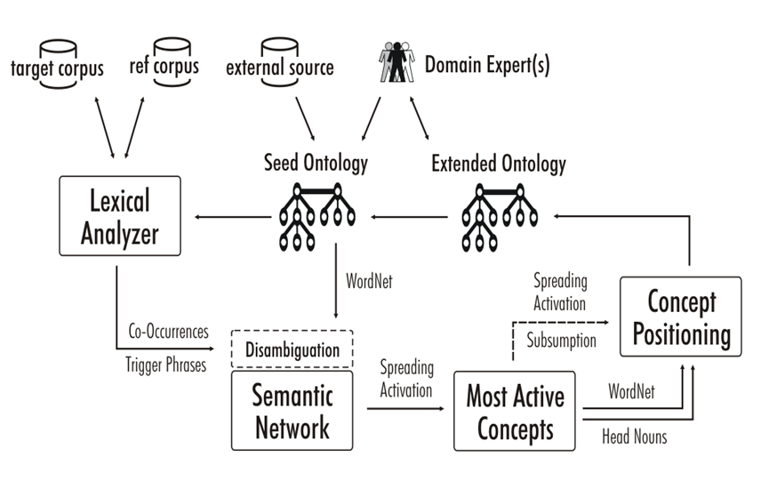
12.1 Ontology Learning from Text – System Overview
A semi-automatic ontology learning system
Wei Liu, Arno Scharl & Albert Weischselbraun, 2005
Associate Prof. Wei Liu, UWA

Slide 24
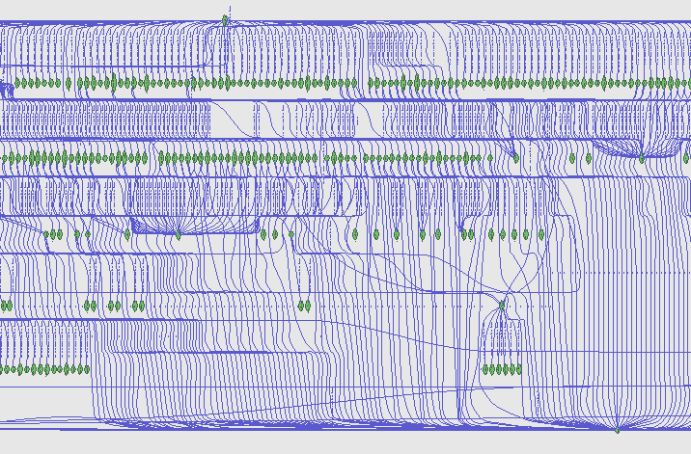
12.1 Ontology Learning from Text – Term Co-ocurrence
Semantic Network
Visualisation
Associate Prof. Wei Liu, UWA

Slide 25
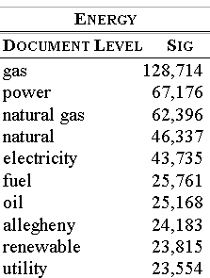
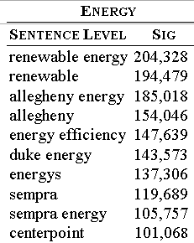
12.1 Ontology Learning from Text – Term Significance
Results of climate change data analysis
Associate Prof. Wei Liu, UWA

Slide 26
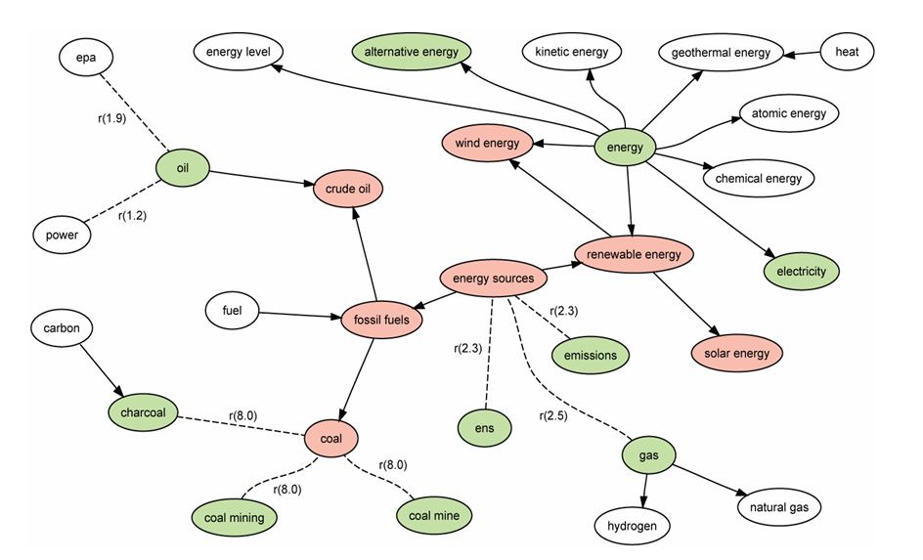
12.1 Ontology Learning from Text – Building Lightweight Ontologies
Spreading Activation
Associate Prof. Wei Liu, UWA

Slide 27
12.1 Knowledge Graph Construction from Text – Text2KG Pipeline
Knowledge Graph Construction From Text
A knowledge graph (KG) is a graph-structured knowledge base that stores knowledge in the form of the relation between entities.
Subtasks of Knowledge Graph Construction
Entity Extraction
Relation Extraction
Axiom Extraction
Note that we do not attempt to link to an existing KG such as Freebase, DBPedia, YAGO, and NELL.
Associate Prof. Wei Liu, UWA

Slide 28
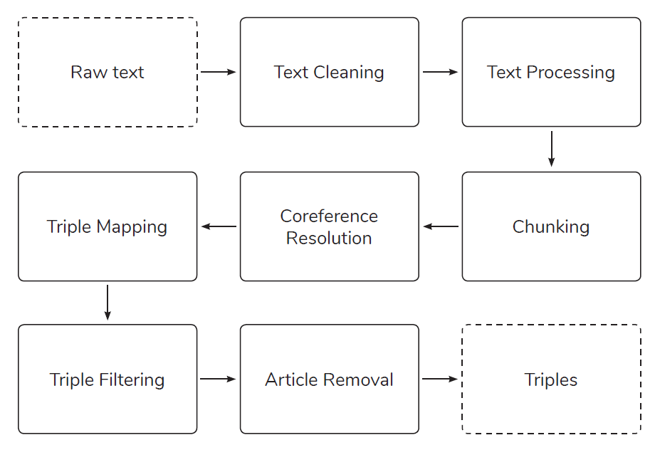
12.1 Knowledge Graph Construction from Text
ICDM Knowledge Graph Contest 2019
M. Stewart, M. Enkhsaikhan and W. Liu, "ICDM 2019 Knowledge Graph Contest: Team UWA," 2019 IEEE International Conference on Data Mining (ICDM), Beijing, China, 2019, pp. 1546-1551.
Associate Prof. Wei Liu, UWA

Slide 29
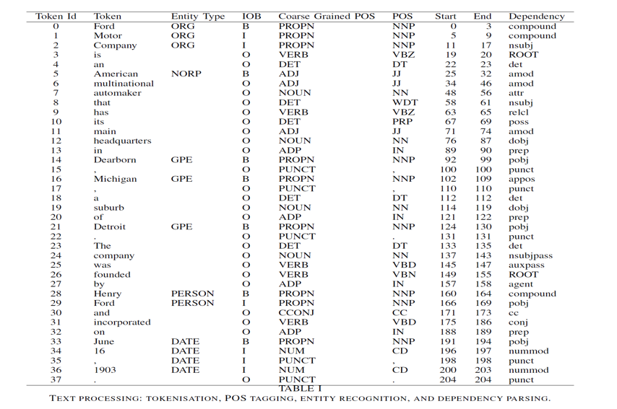
12.1 Knowledge Graph Construction from Text
Text Cleaning and Text Processing
Text Cleaning: special
characters such as hyphen and quotation marks and also break
sentences joined together with no space between them.
Text processing: The text is processed through tokenisation,
POS tagging, entity recognition and dependency parsing
steps using SpaCy.
Associate Prof. Wei Liu, UWA

Slide 30
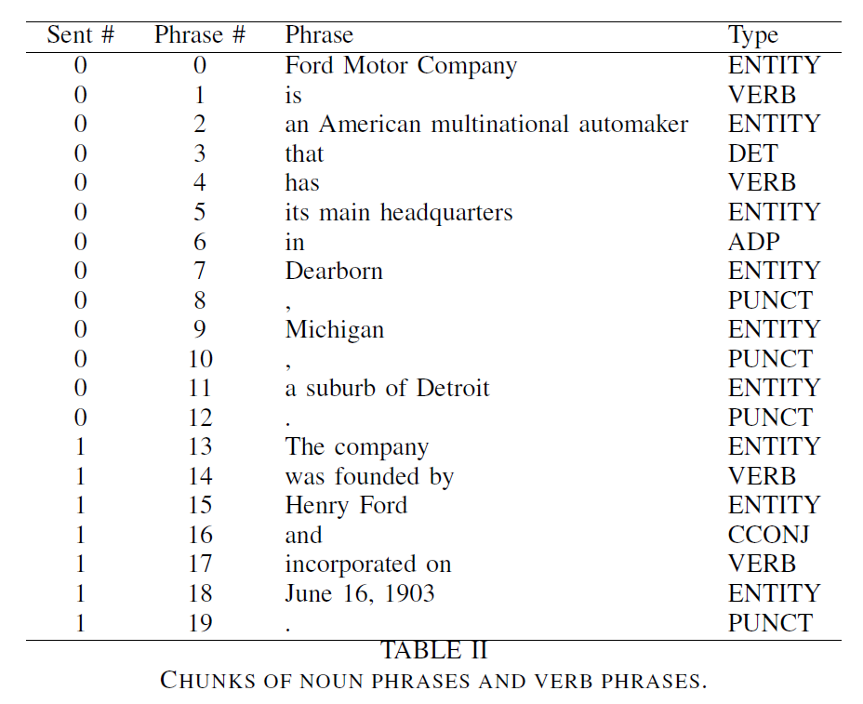
12.1 Knowledge Graph Construction from Text
Phrase Identification – Linguistic Rules
Noun Phrase Chunking:
NP
(NP)
NP + of + NP
NP + NP
Verb Phrase Chunking:
VERB + PART
VERB + ADP
ADP + VERB
PART + VERB11ERB
Associate Prof. Wei Liu, UWA

Slide 31
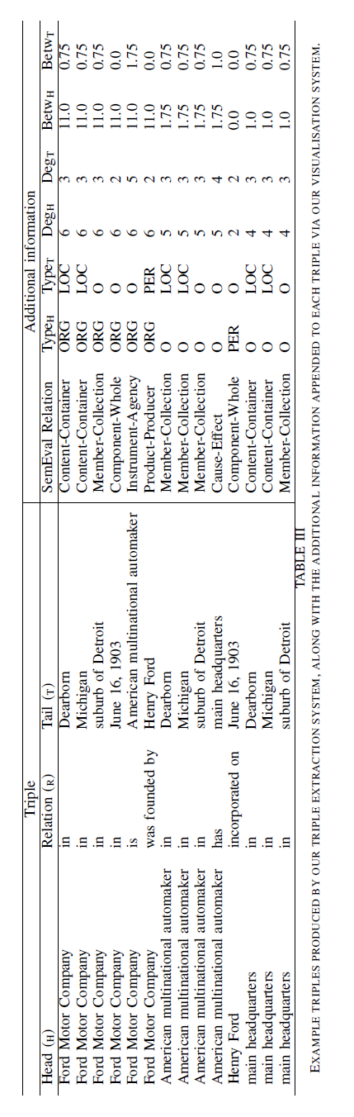
12.1 Knowledge Graph Construction from Text
Triple Creation and Filtering
COREF Resolution *:
Coreference items are resolved by replacing the original phrase with the referred phrase for each item.
Triple Creation: Find triples in the same sentence by finding entities before and after verb phrases;
Document-level triples are obtained by finding shortest path between any pair of entities.
Triple Filtering: remove any triple with a stop word as a head entity. The stop words include NLTK stop words,
names of days (e.g. Monday) and names of months (e.g. January).
Article Removal: articles (a, an, the), possessive pronouns
(e.g., its, their) and demonstrative pronouns (e.g., that, these) are removed from the heads and tails.
NeuralCoref: https://github.com/huggingface/neuralcoref

Slide 32
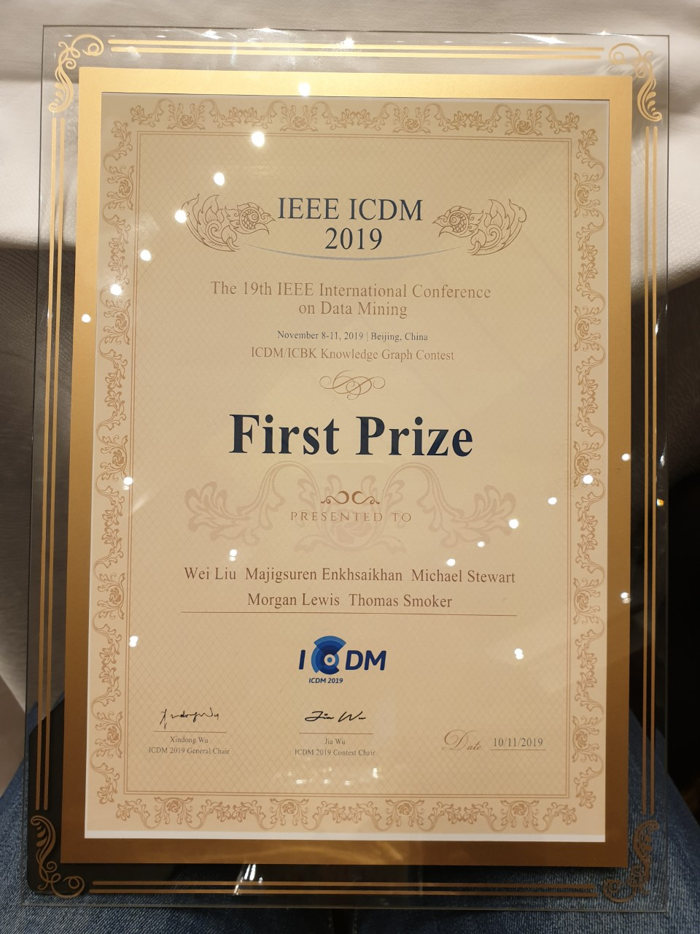
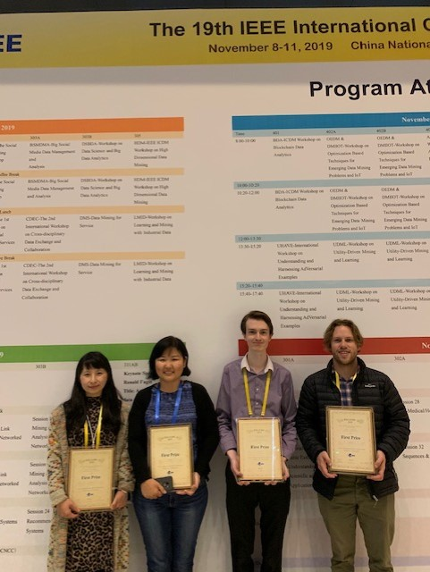
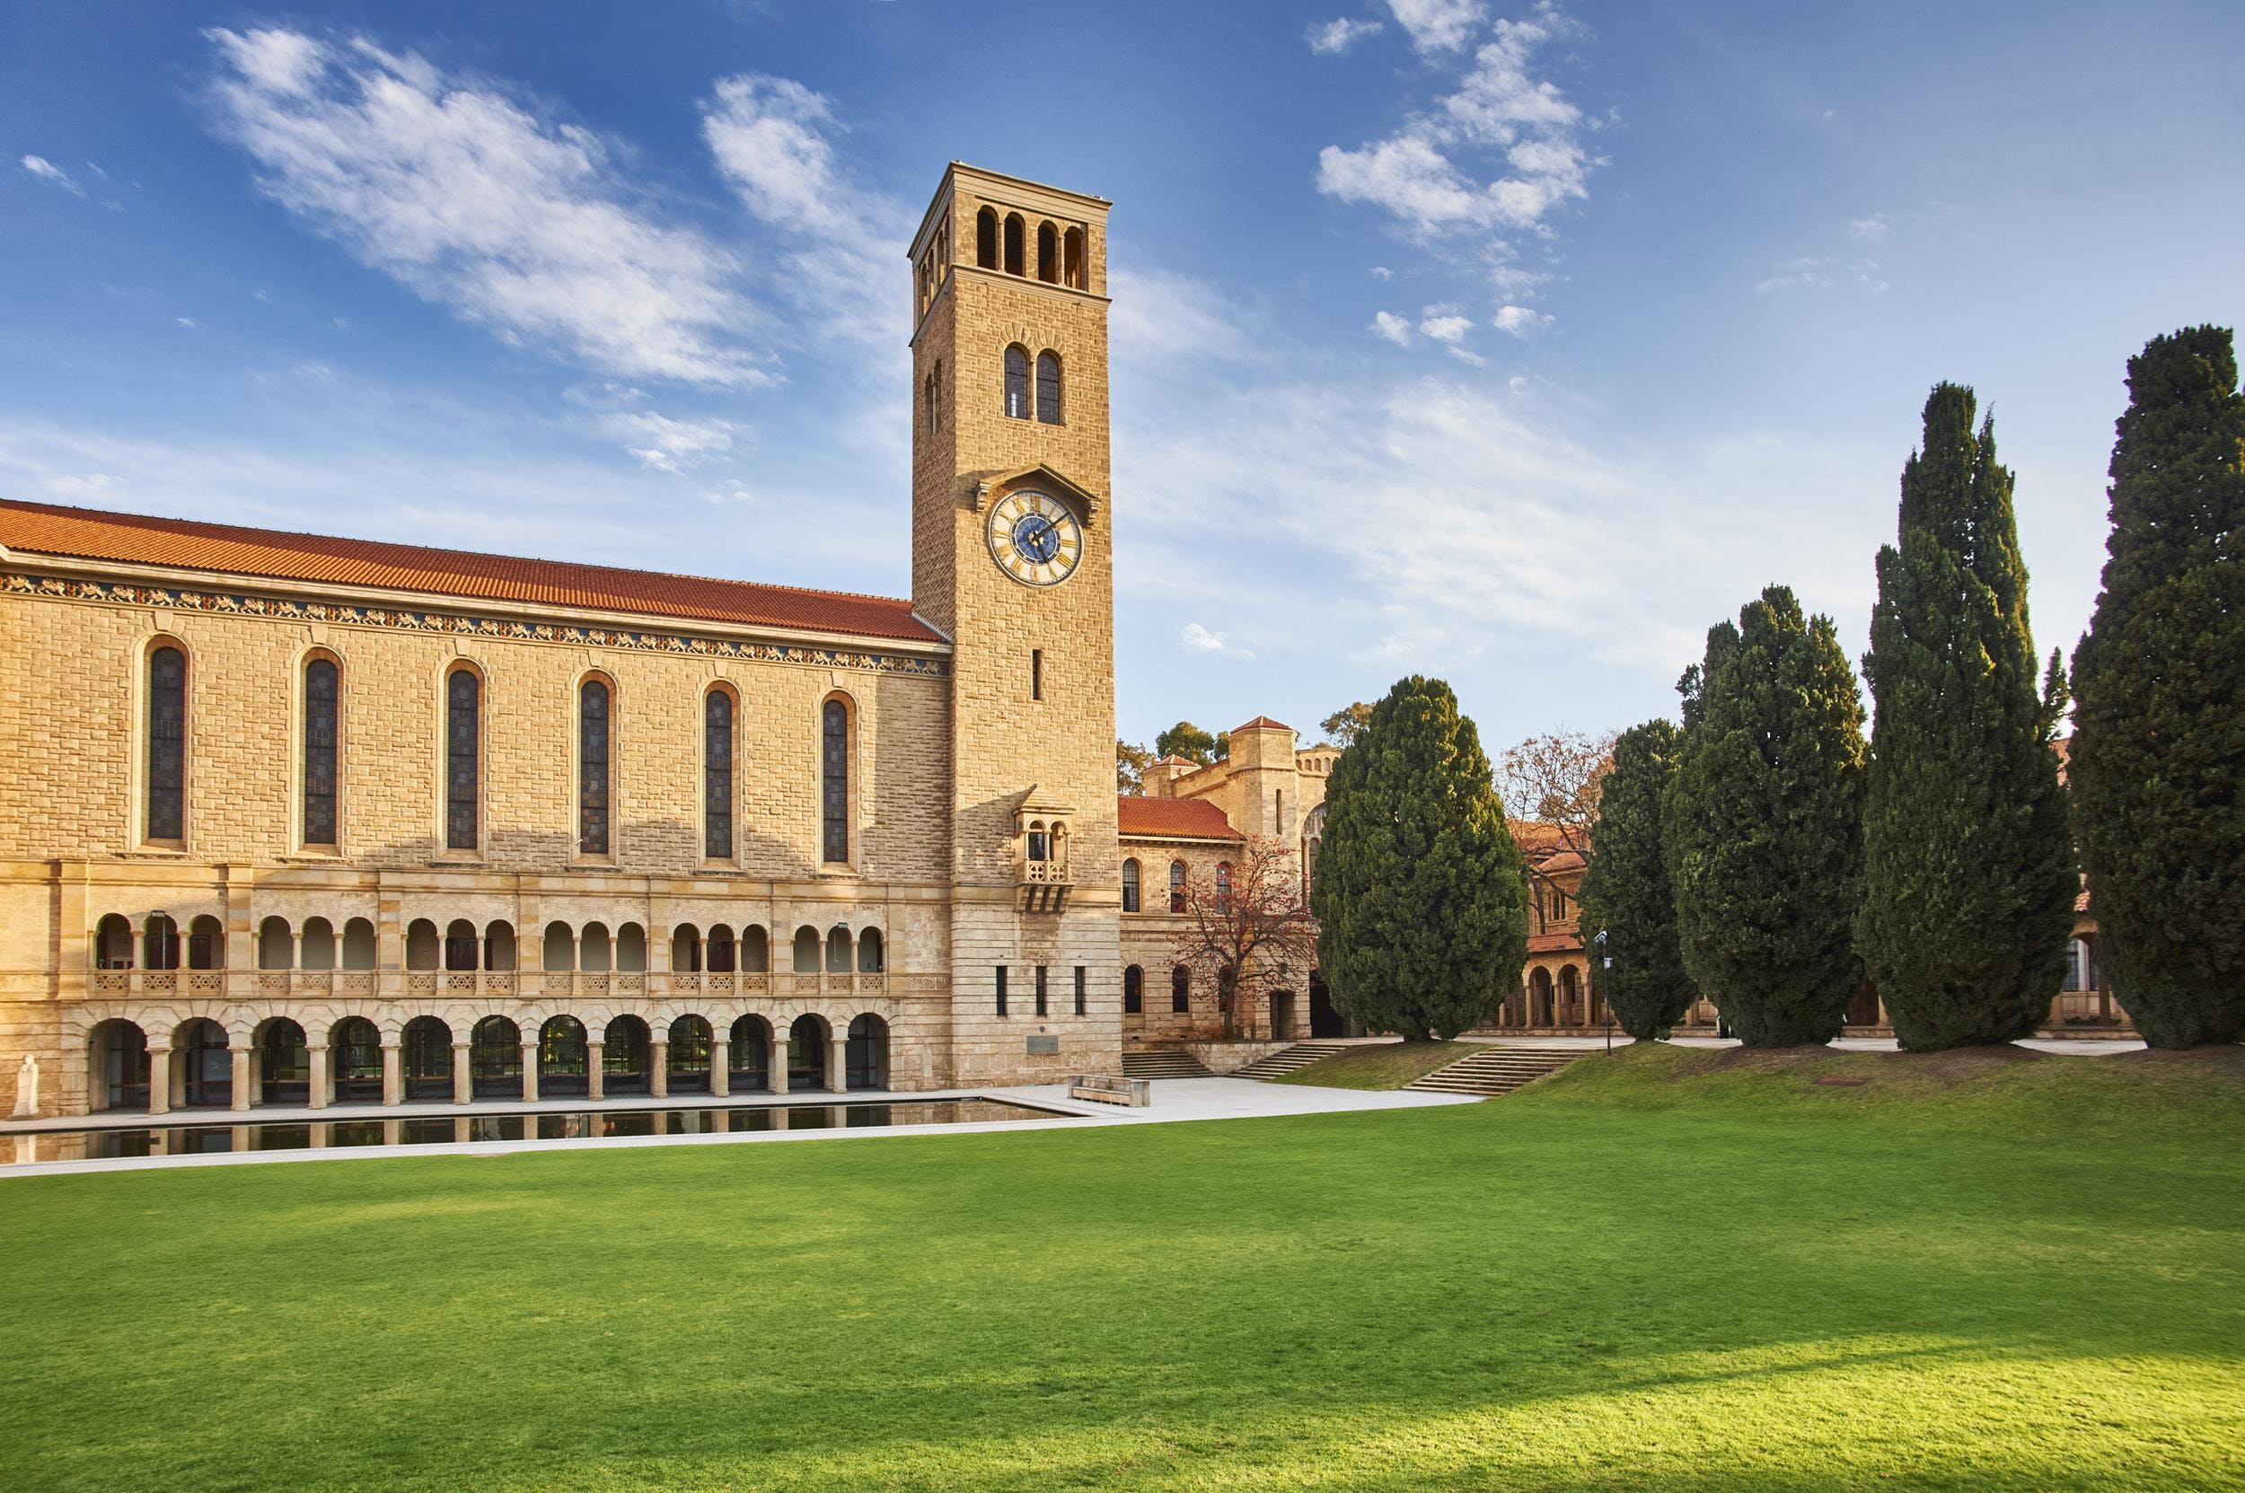
Text2KG: ICDM Knowledge Graph Contest – First Prize
Associate Prof. Wei Liu, UWA

Slide 33
12.2 Word Embeddings

Slide 34
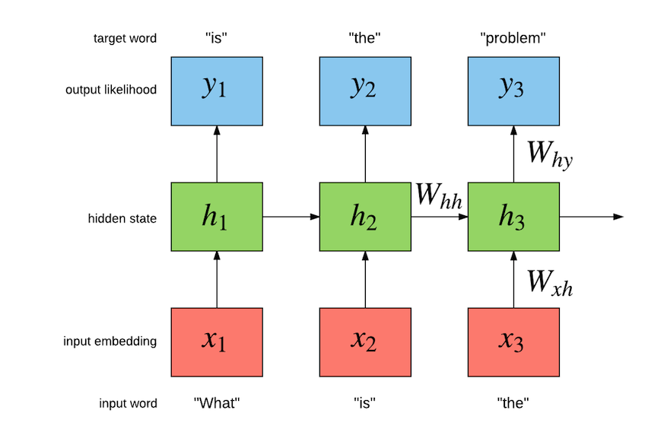
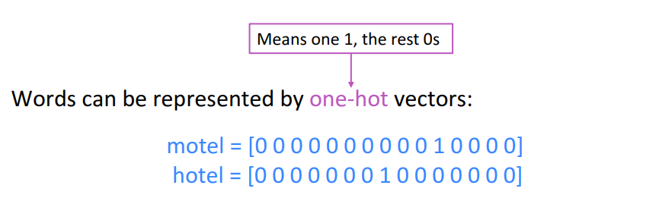
12.2 Word Embeddings: One-hot Vectors
Word representations – one-hot vectors
What is the name of the prime minister of Australia?
What | = | [10000000]
is | = | [01000000]
the | = | [00100000]
name | = | [00010000]
of | = | [00001000]
the | = | [00100000]
prime | = | [00000100]
minister | = | [00000010]
of | = | [00001000]
Australia | = | [00000001]
(Socher, 2018)
Associate Prof. Wei Liu, UWA
Notes:
How do we represent words?
One hot encoding (count vectorising); basic, naïve.
Vector dimension becomes as large as the number of words in the vocabulary. This is not ideal for large ML systems. Othogonality
Socher, R. (2018, January 18). Natural Language Processing with Deep Learning CS224N/Ling284 [PowerPoint slides]. https://web.stanford.edu/class/archive/cs/cs224n/cs224n.1184/lectures/lecture2.pdf

Slide 35
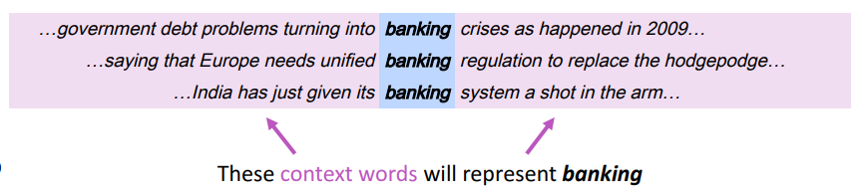
12.2 Word Embeddings: Learning Context
Representing words by their context
You shall know a word by the company it keeps
J. R. Firth 1957
prime | = | [0,0,0,0,0,1,0,0]
minister | = | [0,0,0,0,0,0,1,0]
prime | = | [-0.1, 0.1, 0.2, 0.3, 0.3, 0.4, 0.1, 0.7]
minister | = | [-0.2, 0.2, 0.4, 0.2, 0.2, 0.2, 0.1, 0.6]
One-hot
Embeddings
Associate Prof. Wei Liu, UWA
Notes:
How do we capture semantic and syntactic similarities, relationships with other words, etc.
Concordance
“You shall know a word by the company it keeps” (J. R. Firth 1957: 11)
Distribution representations of words; that is, we want to introduce dependence between words. We are unable to determine similarity between one hot vectors because they’re orthogonal e.g. their dot product is zero.
Socher, R. (2018, January 18). Natural Language Processing with Deep Learning CS224N/Ling284 [PowerPoint slides]. https://web.stanford.edu/class/archive/cs/cs224n/cs224n.1184/lectures/lecture2.pdf

Slide 36
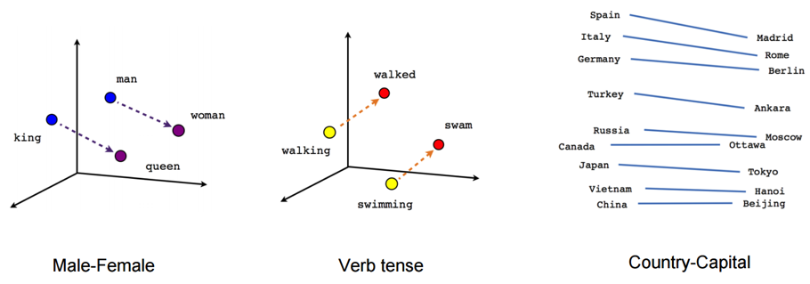
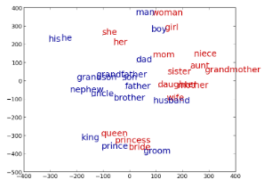
12.2 Word Embeddings: Power of Embeddings
Imagine doing simple math with words
“A is to B as C is to D” tasks
-word_{A} – word_{B} – word_{C} ≅ word
Associate Prof. Wei Liu, UWA
http://rare-technologies.com/word2vec-tutorial/
Notes:
Word analogies. For example: King – Man + Queen = Female
Similarity -> distance; relationship between words -> angle (the same relationship has the same angle).
Non-orthogonal vectors allows us to take advantage of these representations unlike one-hot vecotrs which are orthogonal e.g. 90 degrees apart

Slide 37
12.2 Word Embeddings: Analogy Task Examples
“A is to B as C is to D” tasks
groom bride husband wife groom bride king queen groom bride man woman groom bride nephew niece groom bride policeman policewoman groom bride prince princess | Athens Greece Baghdad Iraq Athens Greece Bangkok Thailand Athens Greece Beijing China Athens Greece Berlin Germany Athens Greece Bern Switzerland | short shorter small smaller short shorter smart smarter short shorter strong stronger short shorter tall taller short shorter tight tighter short shorter tough tougher short shorter warm warmer short shorter weak weaker short shorter wide wider short shorter young younger short shorter bad worse
Associate Prof. Wei Liu, UWA
Notes:
20,000 syntactic and semantic test examples (Google)
The top 30,000 words ranked according to frequency are used for the evaluation shown.

Slide 38
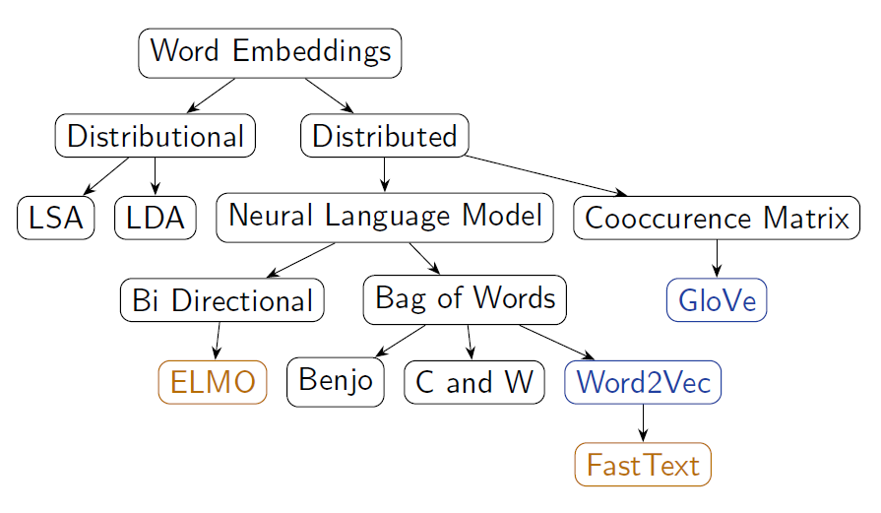
12.2 Word Embeddings: Techniques
Many ways of obtaining word vectors
New techniques being developed every year!
Associate Prof. Wei Liu, UWA
Notes:
Word2Vec (neural embedding model); ‘self-supervised’
1. one-word context (predicting one word given only one word); referred to as a continuous bag of words (CBOW) model. Input is a onehot encoded vector
2. multi-word context (similar to one-word but we need in multiple words)
3. Skip-gram model (opposite to CBOW multi-word). Given word w predict n words surrounding it (windowing).
GloVe (Global Vectors for Word Representation)-> captures the meaning of a word embedding with the structure of the entire observed corpus. This model utilises word frequencies and co-occurrence counts in a unsupervised manner.
ELMO (Embeddings from Language Models)-> Context-dependent embeddings; uses language models to capture embeddings for individual words while conditioning on the entire sentence or document. Conventional embeddings have issues with polysemy e.g. “the bank on the other end of the street was robbed” vs. “we had a picnic by the bank on the river”. Many embedding models find it difficult to distinguish the difference between the use of the word bank. Elmo captures this meaning by conditioning on the context it’s in and the word vector changes based on the words around it.

Slide 39
12.2 Word Embeddings: Word2Vec(tor)
Word2Vec (Mikolov et al. 2013)
For learning word representations using a shallow neural network
No shared parameters across the network
Fast training
Training over Wikipedia snapshot (about 1 billion words) with 50 dimensions takes only 4 hours
Strong representations – previous state-of-the-art performance.
Learned word embedding vectors can be represented as linear translations etc.
vec(king) – vec(man) + vec(woman) ≅ vec(queen)
vec(Paris) – vec(France) + vec(China) ≅ Beijing)
Associate Prof. Wei Liu, UWA

Slide 40
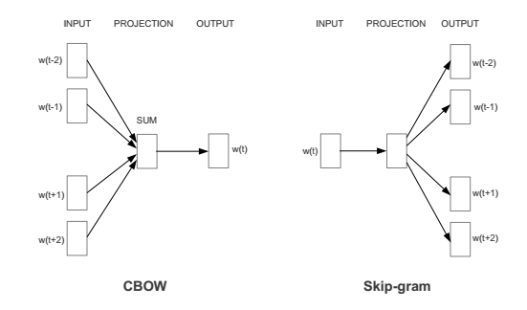
12.2 Word Embeddings: Word2Vec(tor) Continued.
Word2Vec Configurations
Word2vec has two models
Continuous Bag of Word (CBOW)
Predict a word w(t) given its context
Skip-gram models
Predict context words given a word w(t)
Demonstration of word2vec models: https://ronxin.github.io/wevi/
Associate Prof. Wei Liu, UWA

Slide 41
12.3 Topic Modelling

Slide 42
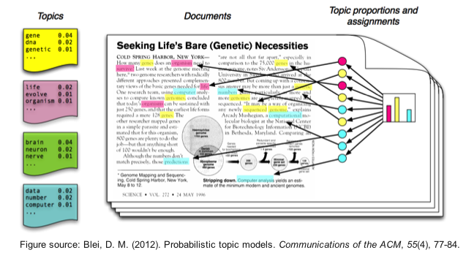
12.3 Topic Modelling
Suppose you have the following set of sentences:
I eat fish and vegetables.
Fish are pets.
My kitten eats fish.
Latent Dirichlet allocation (LDA) is a technique that automatically discovers topics that these documents contain.
bold words under the Topic F, which we might label as “food“.
italics words might be classified under a separate Topic P, which we might label as “pets“
https://www.quora.com/What-is-the-best-way-to-explain-topic-modeling-to-a-layman
Associate Prof. Wei Liu, UWA

Slide 43
12.3 Topic Modelling
LDA defines each topic as a bag of words, and you have to label the topics as you deem fit.
We can infer the content spread of each sentence by a word count: Sentence 1: 100% Topic F Sentence 2: 100% Topic P Sentence 3: 33% Topic P and 67% Topic F
We can derive the proportions that each word constitutes in given topics. For example, Topic F might comprise words in the following proportions: 40% eat, 40% fish, 20% vegetables, …
Associate Prof. Wei Liu, UWA

Slide 44
12.3 Topic Modelling
Three Steps
LDA defines each topic as a bag of words, and you have to label the topics as you deem fit.
Specify how many latent topics are there
For each word, assign a temporary topic, according to a Dirichlet distribution, e.g. kitten -> F
If a word appears twice, each word may be assigned to different topics.
Function words (e.g. “the”, “and”, “my”) are removed and not assigned to any topics.
topic assignment is updated based on two criteria:
How prevalent is that word across topics?
How prevalent are topics in the document?
Associate Prof. Wei Liu, UWA

Slide 45
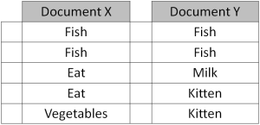
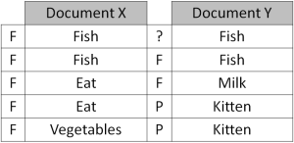
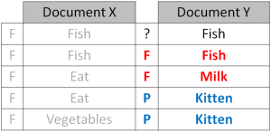
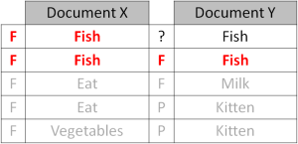
12.3 Topic Modelling
Repeated refinement
The process of checking topic assignment is repeated for each word in every document, cycling through the entire collection of documents multiple times.
This iterative updating is the key feature of LDA that generates a final solution with coherent topics.
Associate Prof. Wei Liu, UWA

Slide 46
12.4 Neural Language Processing

Slide 47
Example accident report
walking in car park from office to workshop and rolled ankle
Associate Prof. Wei Liu, UWA

Slide 48
Example accident report – tagged via entity recognition
activity
location
location
location
walking in car park from office to workshop and rolled ankle
injury
body part
Associate Prof. Wei Liu, UWA

Slide 49
Example accident report – tagged via entity typing
location
location/car park
location location/office
location
location/workshop
walking in car park from office to workshop and rolled ankle
activity
activity/walking
injury injury/sprain
body part body part/leg
body part/leg/ankle
Associate Prof. Wei Liu, UWA

Slide 50
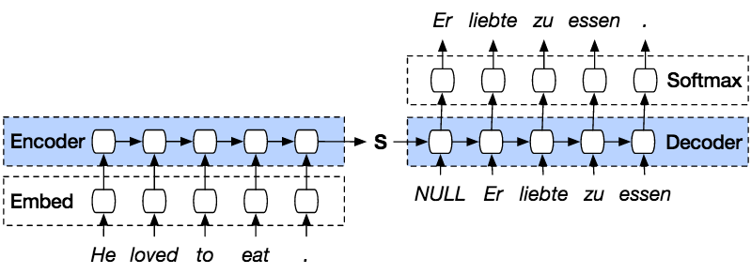
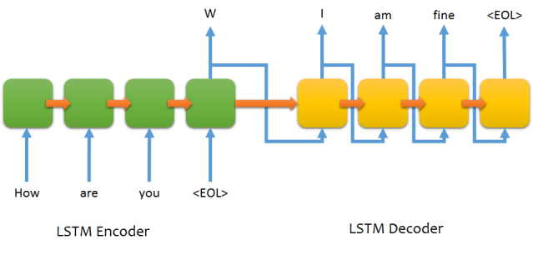
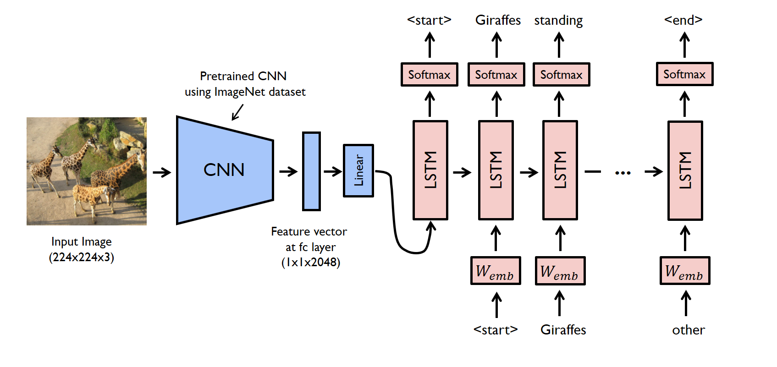
Sequence to Sequence Learning (Encode then Decode)
Associate Prof. Wei Liu, UWA

Slide 51

LSTM
Contains four interacting layers
Associate Prof. Wei Liu, UWA

Slide 52

LSTM
Inside a cell
Associate Prof. Wei Liu, UWA

Slide 53

LSTM – Forget gate
http://colah.github.io/posts/2015-08-Understanding-LSTMs/

Slide 54

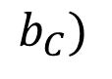
LSTM – Input Gate Layer
$$b_{C})$$
Associate Prof. Wei Liu, UWA

Slide 55

LSTM - Update
Associate Prof. Wei Liu, UWA

Slide 56

LSTM – Output Gate
Associate Prof. Wei Liu, UWA

Slide 57
Sequence to Sequence Learning (Encode then Decode)
Associate Prof. Wei Liu, UWA

